Slide 1

FLIGHT PRICE PREDICTION
Submitted by: SHAAHIDH IRFAAN SHA

Slide 2
ACKNOWLEDGMENT
This includes mentioning of all the references, research papers, data sources, professionals and other resources that helped you and guided you in completion of the project.

Slide 3
INTRODUCTION
Business Problem Framing
Flight fares changes continuously depending on a lot of variables like duration, no of stops, type of class, etc. I have built a model using sufficient data to predict the fare by giving valuable inputs
Conceptual Background of the Domain Problem
The model’s domain understanding is on basic level, journey date/time/year has been separated to find which seasonal month flight bookings are high. Have encoded ordinal and nominal datas
Review of Literature
Fare prediction machine learning model uses two main models, regression analysis and random forest. Random forest always produce better results(accuracy).
Another main observing is, price is mostly correlated to duration and no of stops.

Slide 4
Analytical Problem Framing
Mathematical/ Analytical Modeling of the Problem
Statistical part was to use mean to find the average price of the fare, quantile range was used to find how many outliers were there and how drastically it affects the model. For the model accuracy check we are using r2 score, mean squared error and root mean squared error
Data Sources and their formats
I have scraped data from popular flight booking websites and combined into one excel file and I have separated into train data and test data
Data Preprocessing Done
have separated arrival time, departure time.
Some journey duration did not have hrs or mins, added few lines of code to rectify it
Encoded data depending on what kind of data they are
Dropped all the unwanted columns
Model/s Development and Evaluation
Identification of possible problem-solving approaches (methods)
The approach I took was to find the relation between categorical variables, since a lot of the variables in this dataset were categorical.
I had to use boxplots to find out about outliers and how it affects the model.
Used label encoding and mapping for encoding the datas

Slide 5
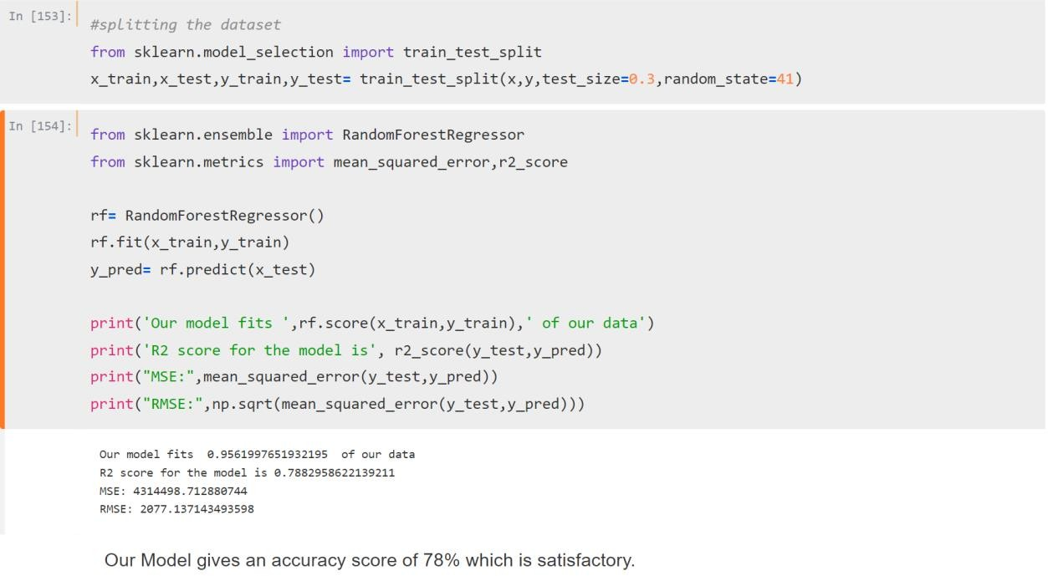
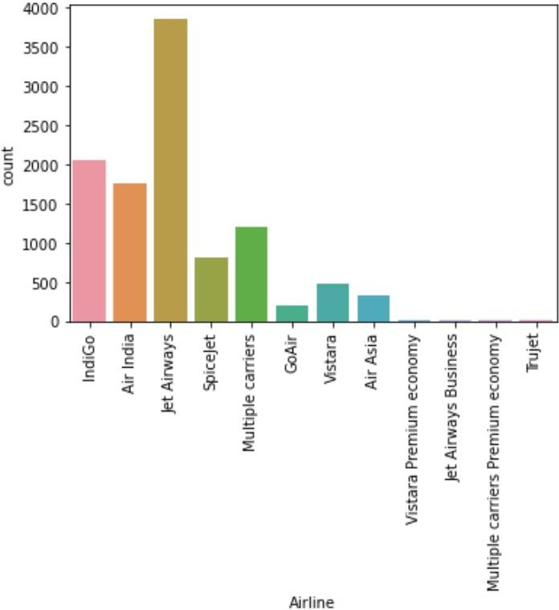
Testing of Identified Approaches (Algorithms)
Random forest training
Run and Evaluate selected models
Visualizations 1)most booked fligts
2)airline vs price

Slide 6
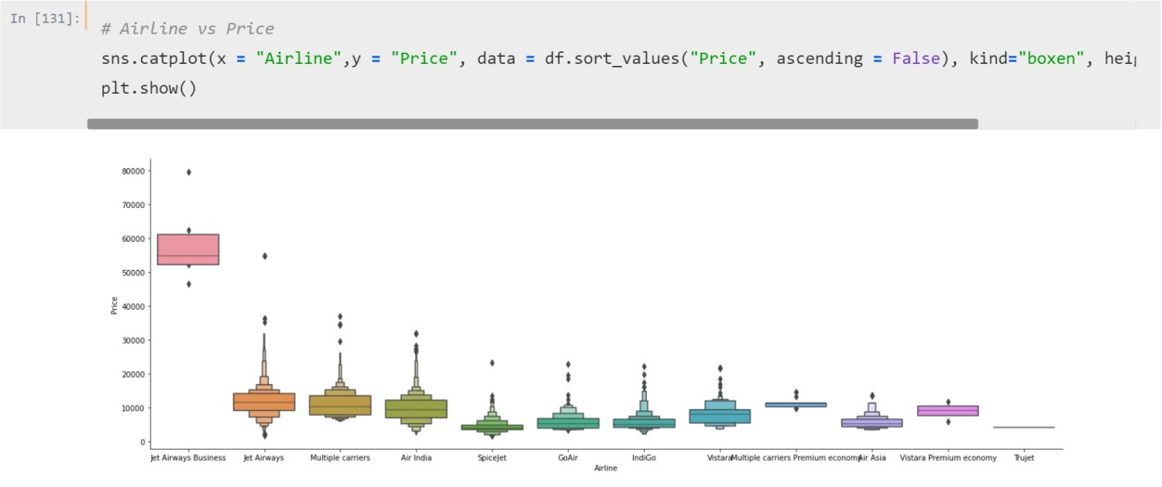
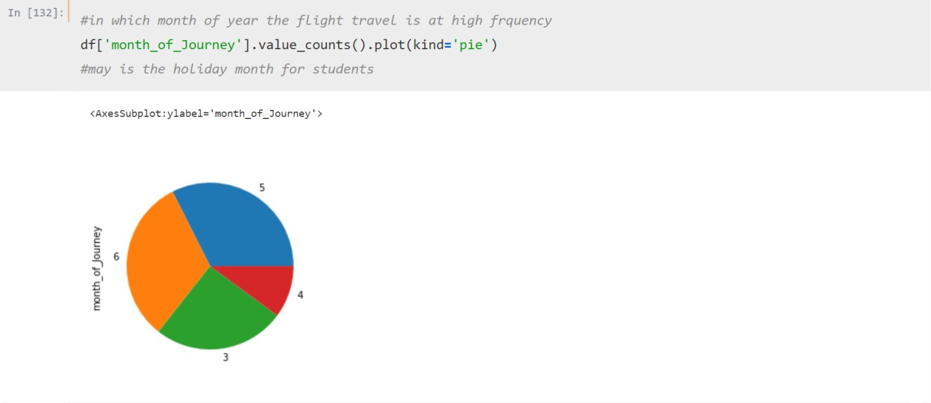
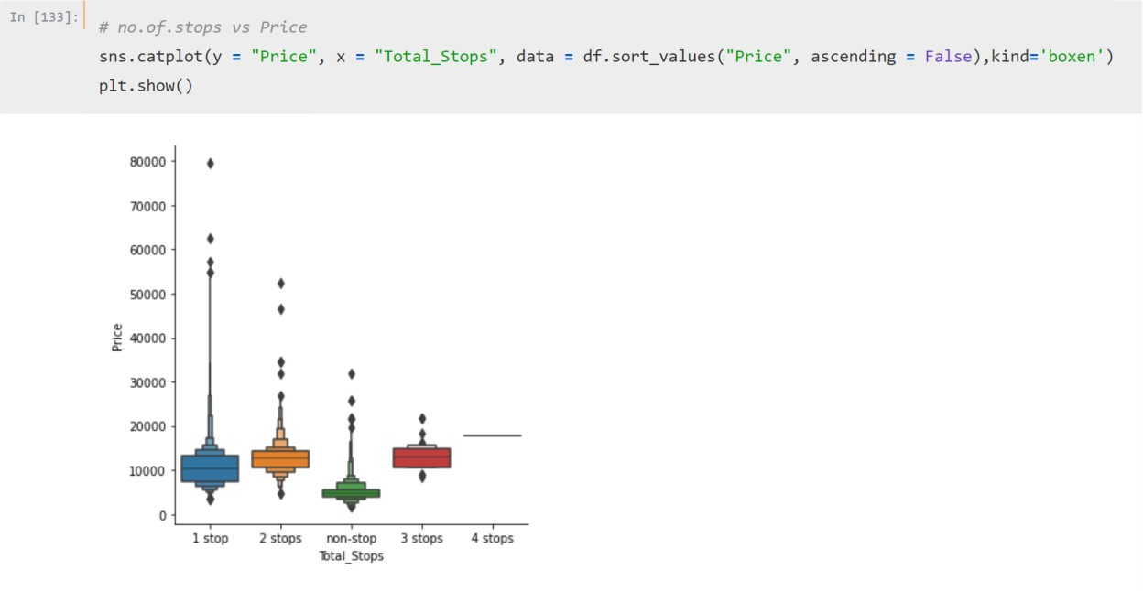
3)which month has the highest booking
4)does the stop increase affect the price

Slide 7
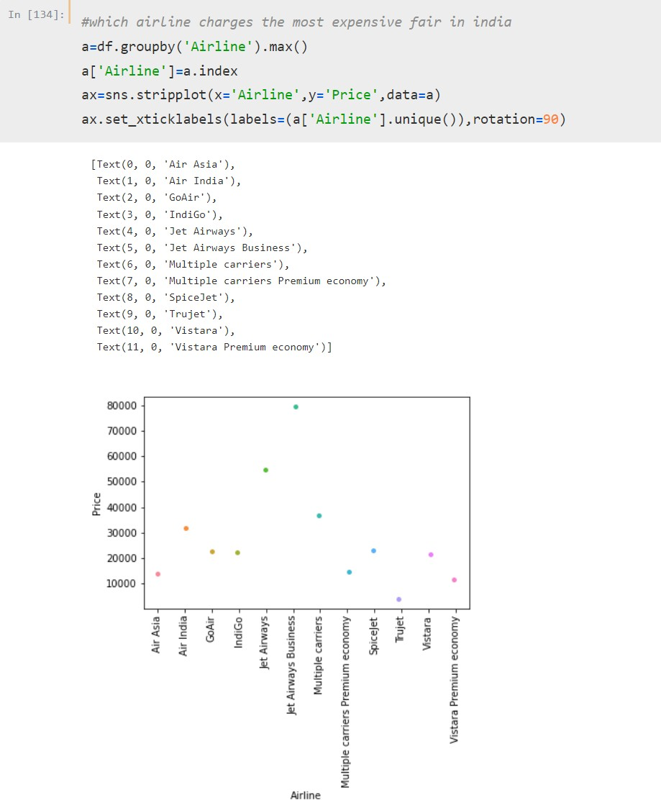
5)which company has the highest fare
6)correlation matrix

Slide 8
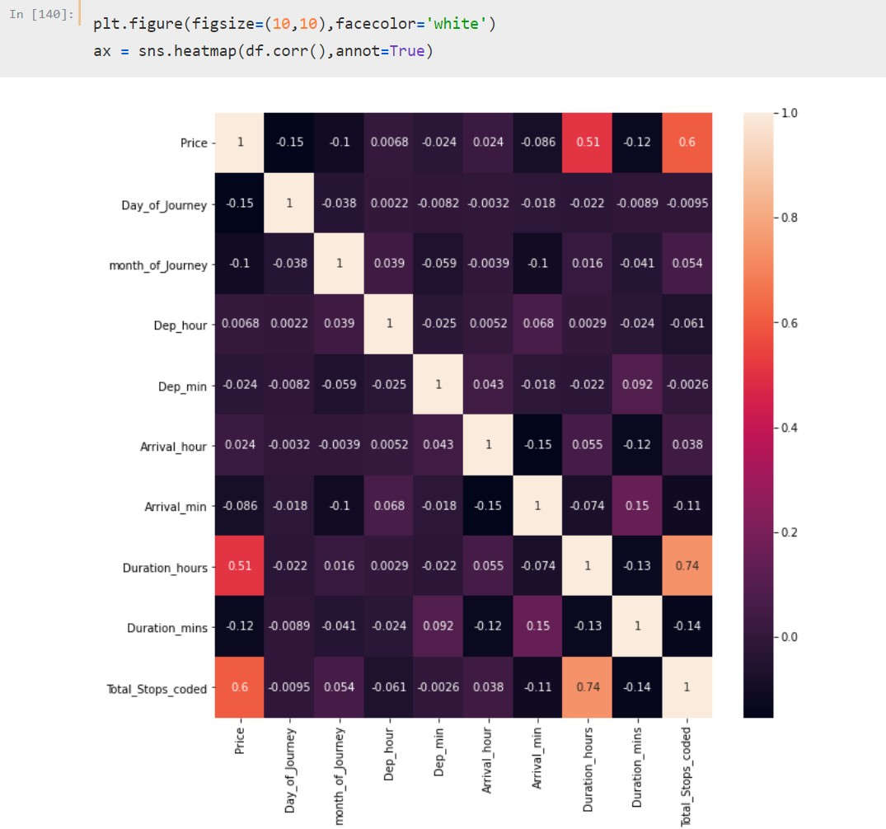
7)correlation with target variables

Slide 9
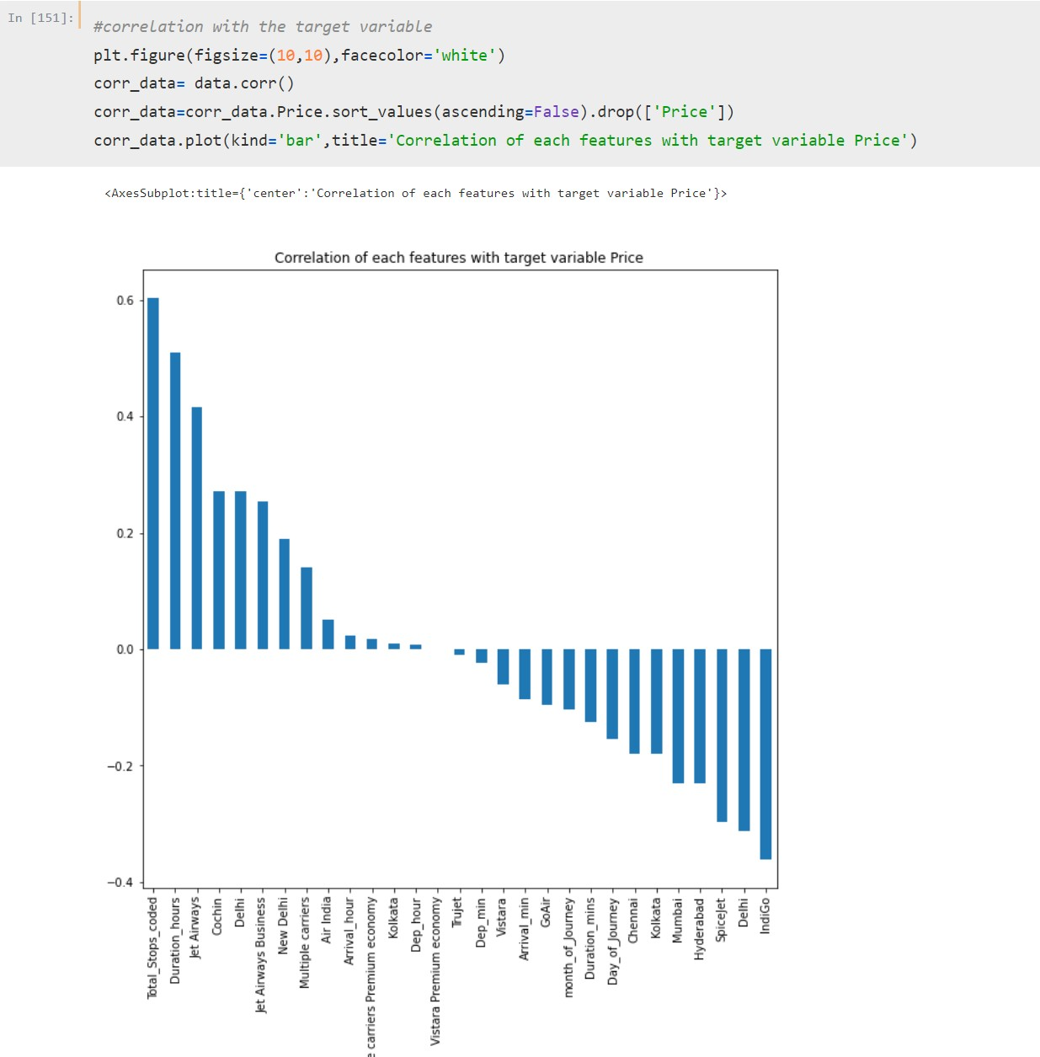
Interpretation of the Results
Our random forest model gives 78% accuracy.
jet airways holds the title as the most booked airlines in India
jet airways business has the highest fares compared to other airline companies
non-stop flights cost less than other options
5th month is the highest booked month in a year
Correlation matrix proves no.of.stops to price and duration to price are highly correlated

Slide 10
CONCLUSION
Key Findings and Conclusions of the Study
Flight with high stop counts are in minimal disposals.
May is the highest booked month since kids have their summer holiday
Additional info has little to no relation to fares
Duration holds the most relation to price.
Limitations of this work and Scope for Future Work
I was not able to predict the price with the type of class(economic, business and first class)
Was not able to find which whether the price vary when booked in day or night

